Slide 1
School Librarians and Curriculum
What effect do school librarians have on the curriculum?
How are librarians effected by the curriculum?

Slide 2
What are a librarian’s responsibilities?
Contributes to the appropriate use of a variety of media (including books, periodicals, television, computers, etc.) which facilitates meeting the goals and objectives of the curriculum.
Provides materials and instruction in the use of library media center resources into classroom instruction and assignments.
Participates in school level curriculum planning.
Notes:
Being a librarian is more than checking in and checking out books. A school librarian plays a major role in the education of students. Librarians must know the standards that the teachers he/she works with are required to teach; however that does not mean that the librarian should memorize the standards. If a librarian is not familiar with the standards , how can he/she find appropriate materials to add to the library collection. These materials could be books, academic journals, videos, maps, etc. that can be checked out by students or teachers. Librarians are not just on the sideline providing support. It is the job of the school librarian to set a time to meet with teachers. That can be done individually, as a grade level team meeting, or meeting with teachers that instruct students on the same subject.

Slide 3
Librarians are Essential
https://www.youtube.com/watch?v=OMfkrDNjiwM

Slide 4
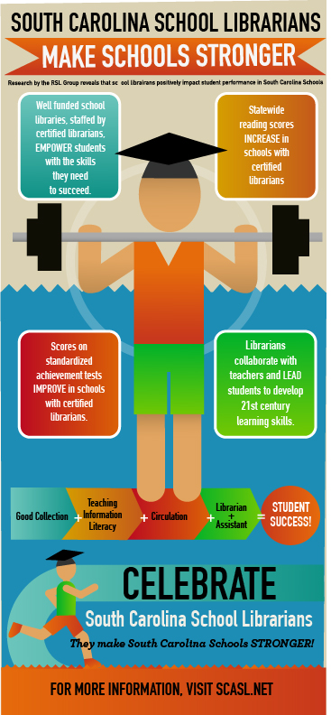
State standards, Standardized testing, and librarians
Standards
Common Core
SC College and Career Ready
Standardized Testing
SCPASS
SCReady
Notes:
According to Library Media Connection One-Question Survey, there were changes to libraries after the implementation of the Common Core Standards. One of the biggest changes was the collection development of libraries. Many libraries had to change their collections by purchasing more nonfiction materials, seeing if their collection included books that could be considered nonfiction (if they were not already), or making sure they were drawing attention to the nonfiction area of their library. There were also changes to instructional practices in the library. Collaboration became a big part of instruction. Many librarians also focused more on inquiry-based learning and using nonfiction materials to drive instruction.
The South Carolina State Department of Education conducted a study that was released in 2014 that showed the effect of school having a full time librarian and a full or part-time library assistant. The overall summary of the study shows that in schools where there is a librarian present, the test scores for English Language Arts and Writing would increase. For the full copy of the study refer to the “References” slide.
(There are two portions to the study. The link provided will send you to a webpage and there will be hyperlinks to lead you to the complete versions of the study.)

Slide 5
In Closing…
This Photo by Unknown Author is licensed under CC BY-NC-SA
Notes:
Libraries and librarians are often times referred to as the “heart” of the school. Libraries are a hub where all within the school can come and receive the resources that they need. That could be a librarian fostering the collaboration between students to successfully research or showing and helping teachers see how the librarian can be used to their advantage. This can happen by a librarian pulling resources that coincide with a standard, meeting with teachers to discuss what materials are available, or how a teacher can intertwine their lesson with that of the librarian.

Slide 6
References
American Library Association. (2017). Roles and strengths of teaching librarians. Retrieved from http://www.ala.org/acrl/standards/teachinglibrarians
Dickinson, G. K. (2015). LMC one-question survey. Library Media Connection, 33(6), 43.
Hampton County School District One. (2018). Library media specialist. Retrieved from https://hampton1.tedk12.com/hire/ViewJob.aspx?JobID=33
Lawson, C., & Laduke-Pelster, F. (2017). CCSS collaboration: How librarians can collaborate with teachers on common core. Children & libraries: The Journal Of The Association For Library Service To Children, 15(3), 14-16. doi: http://dx.doi.org/10.5860/cal.15.3.14
South Carolina State Department of Education. (2014). How libraries transform schools by contributing to student success: Evidence linking south carolina school libraries and pass & hsap results [ Data File]. Retrieved from https://www.scasl.net/assets/phase%20i.pdf
Youtube.(2016). Curriculum matters: School Library Program: School library media specialists as educators. Retrieved from https://www.youtube.com/watch?v=OMfkrDNjiwM

